Slide 1
CS 401 – ARTIFICIAL INTELLIGENCE
LECTURE 11: CHAPTER 04 (LOCAL SEARCH ALGORITHMS)

Slide 2
Hill Climbing:
If the Node is better, only then you proceed to that Node
Algorithm:
1. Start with current-state (cs) = initial state
2. Until cs = goal-state or there is no change in the cs do:
(a) Get the successor of cs and use the EVALUATION FUNCTION to assign a score to each successor
(b) If one of the successor has a better score than cs then set the new state to be the successor with the best score.

Slide 3
Examples of all climbing algorithms
Tic - Tac - Toe
which one to choose?
Heuristic:
calculate lines and move to that place with most wining lines.
X
X
X

Slide 4
Calculating winning lines
X
X
3 winning lines
3 winning lines
4 winning lines
Most winning lines

Slide 5
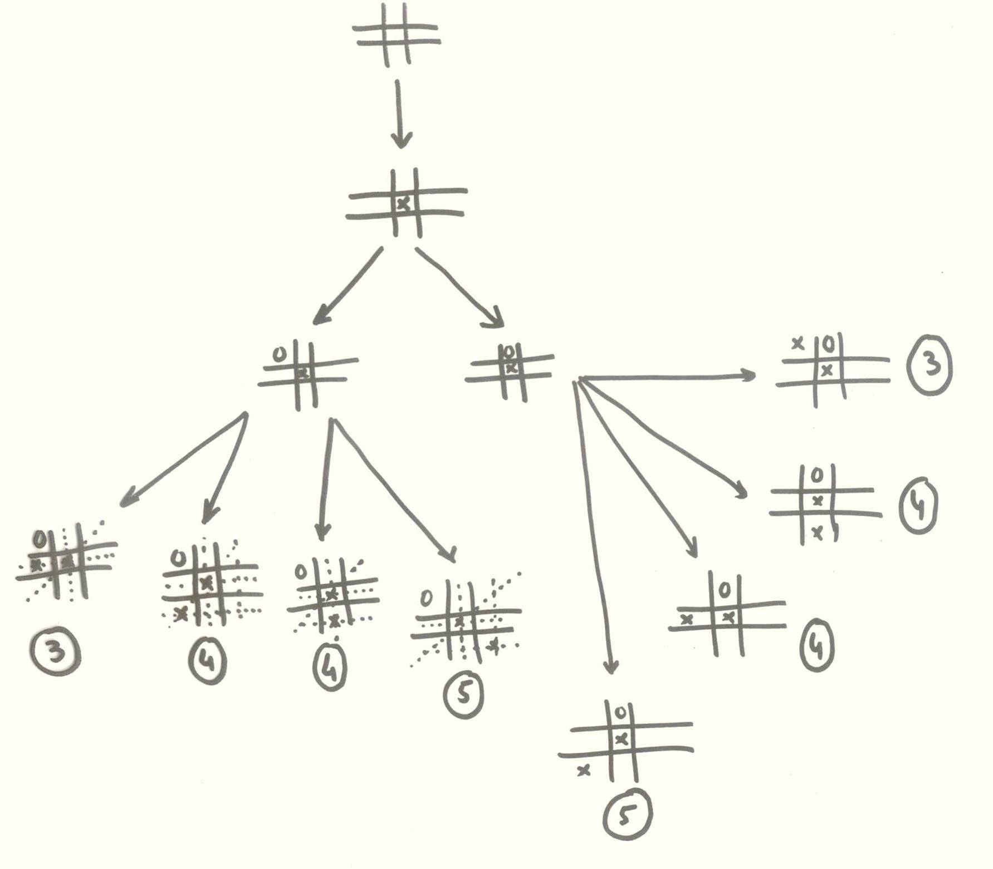

Slide 6
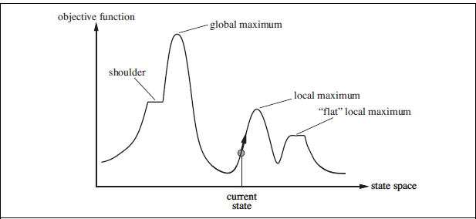

Slide 7
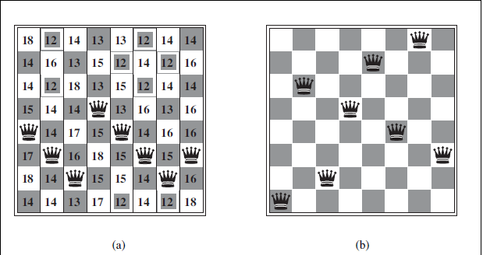

Slide 8
Hill Climbing is Good for:
A limited class of problems where we have an evaluation function that fairly accurately predicts the actual distance to a solution
local maximum/minimum
Hill climbing cannot distinguish between local maximum and global maximum

Slide 9
Hill climbing issues
Stochastic hill climbing
First choice hill climbing
Random restart hill climbing
Expected value (no. of restarts and no of steps required)

